Slide 1
Library Methods II:
Combinatorial Libraries
Notes:
Today we are going to discuss combinatorial libraries and selections.

Slide 2
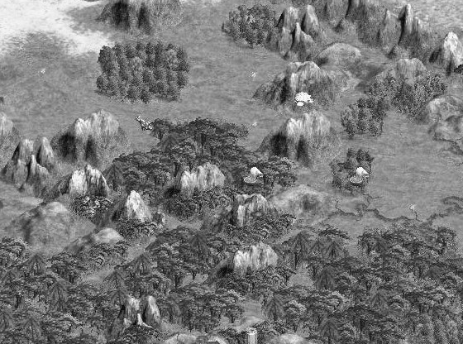
Directed Evolution
Notes:
Last time we talked about directed evolution, which involves optimizing some nascent activity through the introduction of iterative small perturbations. These mutations are generally introduced through error-prone PCR, and the improved variants are identified by screening methods.

Slide 3
Combinatorial Libraries
RFP
GFP
phoA
Notes:
This is in contrast to combinatorial methods in which often a preexisting activity is not present, and a sparse grid of library members is generated to make a large leap in function or to systematically explore a region of sequence space.

Slide 4
Engineering Methods
Combinatorial Libraries
Usually involves large libraries (>10⁶) and selections
Used to find activities that do not pre-exist
Typically involves a single round of mutagenesis
Directed Evolution
Usually smaller libraries (<10⁵) and screens
Used to improve or modify a nascent activity
Involves iterative rounds of mutagenesis
Notes:
Directed evolution experiments typically involve smaller libraries and therefore can be screened individually. They are used to improve or tweak a nascent activity, and they are usually iterative—you make small advances in fitness in each round of mutagenesis.
Combinatorial libraries typically are quite large (greater than 1 million) and therefore require selections. You can use them to find activities that do not pre-exist, and you typically do them only once. It is common to start an experiment with a combinatorial library to get an initial hit, and then optimize that hit through directed evolution methods.

Slide 5
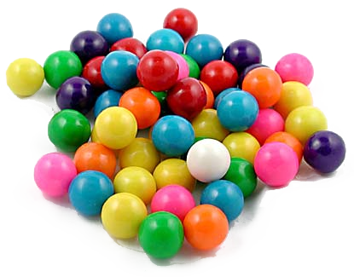
Diversity and Sampling
Notes:
One critical thing you must understand about combinatorial libraries is the means of calculating diversity. For this, let’s consider combinations of gumballs.

Slide 6






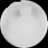
Theoretical Diversity
Consider you have a gumball machine, and there are 20 different colors of gumballs inside, each occurring at the same frequency
If you pick 6 of them and get sequences of 6 colors, how many different permutations of these sequences are there?
1 2 3 4 5 6
Seq1
Seq2
Seq3
20* 20* 20* 20* 20* 20 = 20^6 = 6.4E7
Notes:
Suppose we have a gumball machine, and there are 20 different colors of gumballs inside, each occurring at the same frequency.
(click)
If you pick 6 of them and get sequences of 6 colors, how many different permutations of these sequences are there?
(click)
So, there are 20 at this position, 20 at that position, and so on for 6 positions, so there are 20^6 permutations, or around 60 million variants that potentially could exist within this space.

Slide 7
Measuring library size
When transforming plasmids into cells, it is generally assumed that by far the limiting step is transformation
You should assume that each colony is derived from a single random member of the library
The actual diversity of a library is therefore the number of colonies observed following transformation
Due to the large numbers involved, this is usually quantified by plating dilutions of the library on multiple plates and then back-calculating the diversity
This is referred to as “titering the library”
Notes:
When transforming plasmids into cells, it is generally assumed that by far the limiting step is transformation. You can assume that there are a few orders of magnitude more DNAs in the reaction than actually get into a cell, so you only need to consider transformation. This of course assumes that you are using cells in your experiment. For all in-vitro experiments, you must use other strategies to determine the diversity which involve following how much DNA is present at every step of the experiment.
You should assume that each colony is derived from a single unique member of the library.
So, The diversity of a library is the number of colonies observed following transformation. It is very common for multiple plasmids to enter a single cell under the concentrated conditions used in these fabrication schemes—you must use a lot of DNA to hit these high colony counts. However, that extra diversity is difficult to measure and will depend on the quality and amount of your ligation product. For large libraries, the existence of this cotransformation background can effect the outcome of selections, but it does not errode the confidence in confidence that your library is sufficiently inclusive. Your diversity is minimally the number of transformants you observe—it might be a little higher in practice.
Due to the large numbers involved, this is usually quantified by plating dilutions of the library on multiple plates and then back-calculating the diversity
This is referred to as “titering the library”

Slide 8
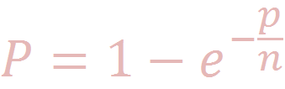
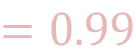
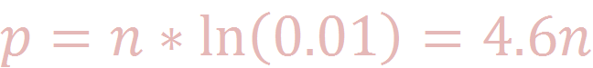
Oversampling
Let’s say I glue the 6 gumballs together into hexamers:
How many of these random hexamers do I have to make to have a 99% probability that I have at least one of each theoretical member?
Probability that a single member exists only once in a library:
p = number of hexamers chosen
(library size)
n = theoretical diversity
Nucleic Acids Res. 1998 Feb 15;26(4):879-86. PMID: 9461443
Notes:
When you construct a combinatorial library, you are not explicitly synthesizing each member of the library. You are sampling this combinatorial space randomly, so there are issues of diversity and inclusion in your library. So, in practice you need to make more library members than are actually present in the theoretical library. Let’s say I glue the 6 gumballs together into hexamers. The analogy of the gumballs is to amino acids (hence 20), or to bases (of which there are 4), or to a set of parts that could be any number. Each member of the library can be considered as the List of chosen members at each site, and here we represent that as a hexamer of gumballs glued together.
How many of these random hexamers do I have to make to have a 99% probability that I have at least one of each theoretical member?
(click)
N is the theoretical diversity which we calculated as 60 million. P is the actual diversity that we’ll measure when we titer the library.
(click)
So, we need to determine what value of P is sufficient to have confidence that at least one of every theoretical member is represented by the library. That calculation, whose derivation is provided in this reference, is given by P= 1-e^-p/n. If we set that value to .99. We can solve for p in terms of n.
(click)
And we find out that that this all boils down to a simple calculation of multiplying the theoretical diversity by 4.6 to get the number of colonies you must hit to have confidence that the library is complete.
(click)

Slide 9
Library Quality issues:
Diversity/Bias
Synthesis-derived base bias
Cloning-derived base bias / biased annealing
Differential growth rates
Uneven spreading on plates
Non-canonical members
Parent vector bleedthrough
Deletions and insertions
Stop codons
Notes:
The other issues with sampling are bias and general library quality. Either of these mechanisms can lead to a library that does not contain all theoretical members.
When you order N’s in an oligo sequence, you don’t always get an equimolar mix of the bases. So, you need to sequence a few clones and confirm that they came out well balanced. Over the years, oligo quality has improved, and usually this isn’t a big problem, but you do need to check it. If they are not random, resynthesizing the oligo usually will fix the problem.
Even if the oligos are truly random, some methods used for fabrication, notably QuikChange, can cause bias due to biased annealing of the oligos. Let’s say you put an extended run of N’s in an oligo. When that sits down on a DNA during PCR, those oligos that have higher homology to the substrate will have a higher Tm and under some circumstances will preferentially bind. This can be improved by making sure you include at least 20bp of homology in the annealing region of your oligos and avoiding any situation in which you are annealing to N-containing regions of an oligo against each other.
In the early days of doing this, much interest was in antibodies, and many of these genes were toxic to the cells. When you make libraries, many of the variants will be altered not just in their molecular function properties, but also in terms of their expression and toxicity profiles within the cell. So, some members will grow better than others and can (in the worst case scenario) take over the library.
You can also cause bias by growing your cells unevenly or over-diluting them during an outgrowth step. For example, let’s say you spread your library on plates, but you do not do so uniformly. You get some regions of the plate that are very sparse and others very dense with colonies. Since colony size is dependent on the the local density, you’ll get smaller colonies in dense regions. As a result, those colonies that landed in a sparse region of the plate will become overrepresented in your library causing bias.
There are also some general quality issues you must consider in your library. For example, if you do not be careful to choose a vector in which the insert is 1/3 to ¼ the size of the entire plasmid, you’ll get monocut vector in your digest that gives rise to a parent vector background. So, it is not uncommon to make a large library that in practice is 90% parent plasmid. If you get this problem, you can fix it by pasting in a differently-sized spacer into your plasmid, and then making a new digest from that clone.
The processes of oligo fabrication and assembly can cause other kinds of errors. It is not uncommon to have a high frequency of point deletions around NNK sites in a library. This often can be resolve by re-synthesizing the oligos, but sometimes it is caused by the assembly steps in which case you might consider a different fabrication strategy.
If you do NNK mutagenesis, there will be TAG codons present. If you are seeing TAAs or TGAs, then those aren’t supposed to be present and you should be worried. If you are seeing TAG codons at a rate higher than 1 in 32, then there is bias in your library that is likely resulting from toxicity of the full-length protein.

Slide 10
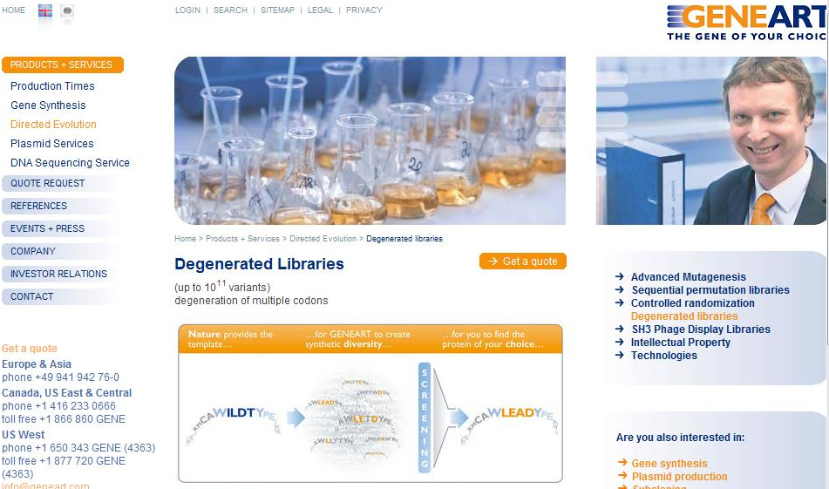
Library Construction: Synthesis
Notes:
Several gene synthesis companies offer combinatorial libraries as a product. Personally, I’ve never used such services since they tend to be expensive. However, combinatorial library fabrication can be very difficult, particularly for someone doing it the first time in a setting devoid of experience. So, it’s something to consider. Whoever makes the library, there are a finite number of methods used to make them, so let’s go through them.

Slide 11

Combinatorial Libraries
Notes:
The methods for fabricating combinatorial libraries are essentially the same techniques used to do normal cloning such as overlap extensions, pcr, soeing, eipcr, and so forth. But with a tweak—often the oligos will contain degenerate bases or you will employ mixtures DNAs.

Slide 12
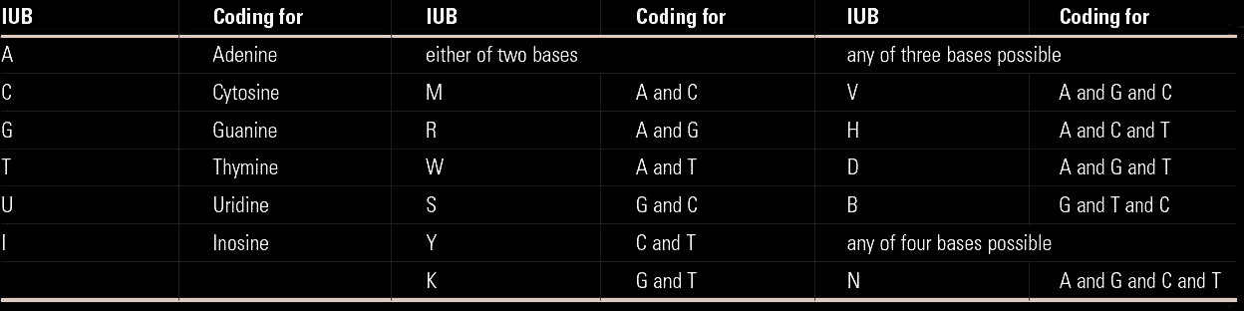
Degeneracy Codes
NNK replacement of codons
For “Saturation Mutagenesis” of proteins (not relevant to RNA/rbs/promoter/etc.)
Theoretically, there are 32 possible “NNK” codons
Eliminates all stops but TAG, fairly equal balance of all amino acids
Codon NNS mutagenesis is popular, achieves a similar balance
Other degeneracies can bias towards particular types of amino acids
For an extra charge, bases can be “premixed” which often results in less bias towards particular bases
Can also now premix triplets phosphoramidites
http://andersonlab.qb3.berkeley.edu/Software/Degenerator.html
Notes:
Most combinatorial libraries involve degenerate bases. This diversity is introduced during oligonucleotide synthesis by mixing together phosphoramidites prior to a round of coupling. You order this mixing in an oligo by putting degeneracy codes instead of A,T,C, or G into the sequence. So, a sequence like GGCATNNKCCATG can be pasted directly into the web interface, and they will interpret that as mixtures.
<click>
This sequence, NNK, is very commonly used in combinatorial experiments since it can be used for saturation mutagenesis. It allows you to replace a single codon of protein, that say, encoding threonine, to instead encode all 20 amino acids plus one stop codon. The sequence has two N’s with diversity of 4 (so, A,T,C,G that’s four options), and one K with diversity of 2 (G or T). So the diversity of the NNK sequence is 4^2*2^1, which is 32 possibilities. The reason you use NNK instead of NNN for saturation mutagenesis is that the full 64 codons are more biased – there are 6 codons for some amino acids and only 1 for others. In NNK, there is either 1 or 2 of each amino acid, so it is more balanced and you have less bias thereby requiring a smaller library.
There are TAG stops included in NNK, but only this stop codon.
An alternative degenerate codon is NNS, which has basically the same balance profile as NNK, and you’ll see that pretty frequently used too.
If you want to include just a few amino acids at a site, such as just the hydrophobic residues, there are other degeneracy codes for this. At the URL below, there is a webtool that allows you to type in the amino acids you want, and it will list out the options for you.
For an extra charge, you can ask that the bases be ‘premixed’ rather than mixed online. What this means is that they will put A, T, C, and G at equal amounts (adjusted for coupling efficiency) into a single bottle, and then draw aliquots of bases from this. In contrast, online mixing does the mixing on the column, and it can lead to low amounts of bias. This is more an issue with the aptamer-style libraries than protein libraries, and online mixing is usually sufficient for short runs of N’s.
You can also order premixed triplets. So, for example, you could ask them to mix triplet phosphoramidites like GGG and TTT and AGC which would encode three and only three amino acids (Gly, phe, and ser). However, It’s very expensive.

Slide 13

Library Construction: Klenow
Polymerase
Oca939F Forward construction of N8 library CcatagaattcggagagatgccggagcggctgaacggaccggtNNNNNNNNaccggagtaggggcaactctacc
Oca939R Reverse construction of N8 library
gtcatctgcagtggcggagagagggggatttgaacccccggtagagttgcccctactccgg
J Mol Biol. 2001 Mar 30;307(3):755-69. PMID: 11273699
Notes:
One of the simplest ways of making a combinatorial library is to employ an overlap extension reaction also known as a Klenow extension or wobble. The differences between these terms deal with the details of which polymerase and temperature conditions you employ, but the oligo design is the same for each. You learned this method as a means of making short parts on the size range of 30 to 130 bp in length, and those size constraints similarly apply here. This approach is useful when all the diversity you wish to create is localized to a small region of the sequence, and you can have restriction sites fairly close to that site.
Here we’re looking at a library of tRNA-coding genes in which the anticodon loop is replaced by 8 random nucleotides. You would order two oligos with 5’ tails, in this case ecori and psti restriction sites, and then the tRNA sequence. The last 20 bp of the oligos need to be complementary to one another so that they can anneal, and then a DNA polymerase will extend the sequences to full length. You’d then digest with EcorI and PstI and ligate the material into a vector containing promoters and such.

Slide 14
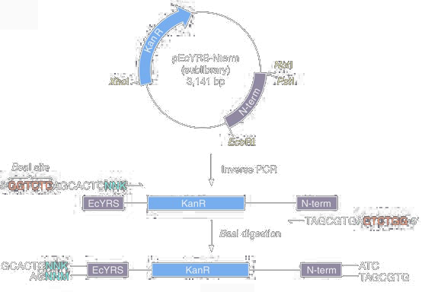
Library Construction: EIPCR
Nat Protoc. 2007;2(10):2590-600. PMID: 17948002
Biotechniques. 1992 Aug;13(2):214-20. PMID: 1327007
Notes:
For very short regions, such as those less than 30 bp, EIPCR is the method of choice. Here you PCR off a wildtype template introducing degenerate bases into the PCR oligos. You then digest and ligate to close the circle back into a plasmid. An overlap extension library is the least biased route, but it requires good restriction sites nearby which is often problematic, particularly when the target sequence is in the middle of the protein. EIPCR can be done with type IIS restriction sites leading to scarless closure of the circle. It therefore is very useful for NNK saturation mutagenesis since you can iteratively perform EIPCR at each site. So, if there are 3 distinct zones that need to be saturated, you’d hit one site first, then use that sublibrary as a template to mutate the second site, and then this for the third. For large saturation libraries, this is the most robust option. You can typically expect around 10^6 colonies from an EIPCR, so you will need to employ additional tricks to get to libraries larger than this.

Slide 15
Library Construction: SOEing
NNM
NNM
PCR
PCR
PCR
NNK
NNK
NNM
NNM
PCR
EcoRI
BamHI
NNK
NNK
NNM
NNM
Notes:
A more traditional but still popular option is to employ SOEing. In this context, it is often called other names like cassette mutagenesis, but all the nomenclature in this space is a little ambigous. The bottom line is you will use PCR to construct a series of short doublestranded fragments that span the length of your gene. Each fragment shares around 20 bp of homology to the next such that they can be assembled together by SOEing. You design the break points in the strategy to be right next to the sites of saturation and incorporate the NNK sequences into the oligos.
This method is a double-diamond level of difficulty. It’s something that very experienced molecular biologists can do pretty well, but is deceptively difficult for a first-timer. In general, most applications in which you might consider doing SOEing can be more easily done by EIPCR. Though SOEing on paper is the faster experiment, it is also more likely to require a lot of tuning of the fragment concentrations and conditions to make the thing assemble properly. So, in practice it usually takes more time than the iterative EIPCR approach.

Slide 16
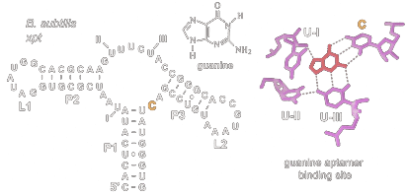
RNA Libraries: SELEX
Template oligos:
GAGGATCCCGAACGGACNNNNNNNNNNNNNNNNNNNNNNNNNNNNNNNNNNNNNNNNNNNNNNNNNNNNNNNNNNNNNNNNNNNNNNNNNNNNNNNNGCACACGCGGAATTCCCTATAGTGAGTCGTATTA
T7 Universal Promoter Oligo:
TAATACGACTCACTATAGGG
Notes:
Alright, let’s look at some examples of types of popular libraries. The oldest and still very commonly used library are aptamer libraries. Here we illustrate a library used to generate quanine-binding RNA aptamers. You order a template oligo sequence like this one with around 40 or more N’s in a row. On the ends there are constant sequence such that the sequence can be amplified by PCR. One of these sites is the T7 promoter sequence. If you also order the T7 universal oligo, you can anneal these two DNAs, and this is sufficient for in vitro transcription with T7 RNA polymerase. Typically 10^15 member libraries are used in aptamer and ribozyme libraries, and when you do the math of how that plays out, you are dealing with a transcription reaction on the scale of 500 uL or so. So, this is something you can do in a normal eppendorf tube.
You can just anneal the oligos and then make transcript, but it is fairly common to first do an overlap extension step and then use the double-stranded product as template for transcription as a quality control adjustment.

Slide 17
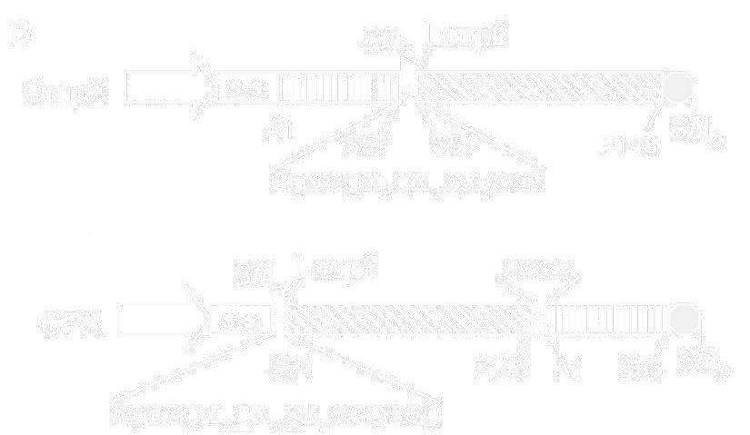
Random Peptide Libraries
Protein Sci. 2006 Apr;15(4):825-36. PMID: 16600968
Notes:
You can use overlap extension derived libraries to encode peptides. Here the authors are encoding 11 ‘x’s’ in a sequence with two cysteines sandwiched in between. So, each of these X’s would be encoded with an NNK code. They’d order two oligos containing the NNKs for overlap extension, and then subclone the library into an SfiI site of a cloning vector. The result here is the insertion of the peptide into the loop of a cell-surface displayed protein. So, these random peptides ultimately get directed to the surface of the bacterium.

Slide 18
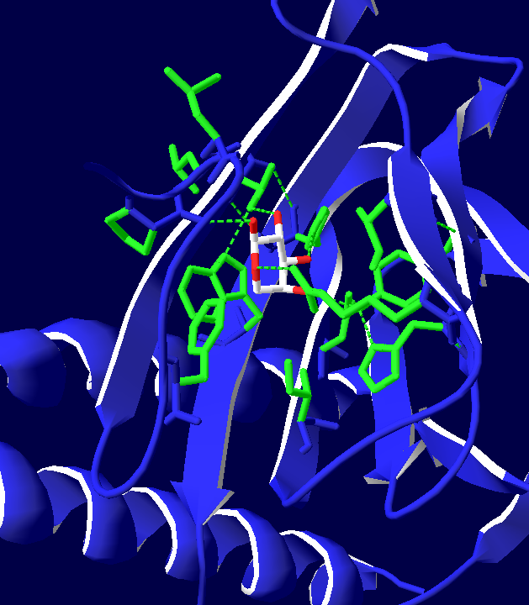
Active-Site Saturation
NNKNNK
NNKNNK
NNK
With NNK saturation can mutate up to 6 sites
Libraries of this type have a very high percentage of members with no activity
The rare “hits” require selections
Best strategy for large leaps in substrate specificity
Notes:
A very common application is active site saturation. On the left is the crystal structure of AraC, the transcription factor that binds arabinose, and I’ve highlighted the residues within 5 angstroms of the arabinose ligand. At most, you can cover the library of up to around 7 amino acids with full NNK saturation. With larger libraries, you will undersample the library and might get an all-dead set of members. This type of library is best achieved by EIPCR, but it can also be done by SOEing as discussed before. These libraries get huge quick, and you will usually see them paired with powerful selections. This type of library is the best strategy for achieving large leaps in substrate specificity such as changing the ligand of a transcription factor, or the subsrate specificity of an enzyme.

Slide 19
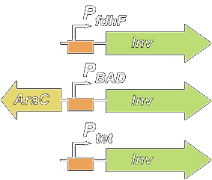
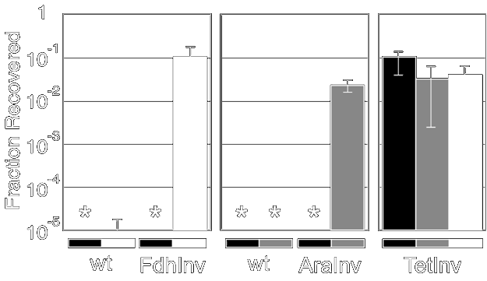
RBS Libraries
FdhInv - Anaerobic Induction
AraInv - Arabinose Induction
TetInv - Constitutive
Anaerobic
Arabinose
Normal
J Mol Biol. 2006 Jan 27;355(4):619-27 PMID: 16330045
Notes:
Saturation mutagenesis can also be applied to regulatory elements. A very common trick in synthetic biology is to construct RBS libraries out of a genetic construct. Here, we are trying to adjust the RBS of a gene called invasin such that the expression of the gene is dependent on the promoter upstream. When you simply put a promoter in front of gene, very often you will get a consitutive on or off device because the rates don’t match up. By adjusting the RBS, you can tune the amount of protein made per transcript up or down and make them match.

Slide 20
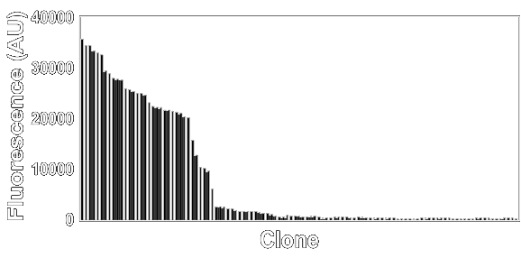
RBS Libraries
RBS
Start
Wt
library
CAAGGAATTAACCATG
NNNGGAATTAACCRTG
Notes:
Here is one example of an RBS library, but other such perturbations give very similar results. We start with some wild-type sequence, and here I am showing the 5’ UTR with the start codon and Shine-Delgarno sequence (otherwise known as the RBS or ribosome binding site). If you saturate the bases partially overlapping the RBS and the first base of the start codon, you get a library that is 50% dead but the other 50% has a nice distribution of activity levels. Here, we show data for doing this experiment with RFP showing the profile of activity present.

Slide 21
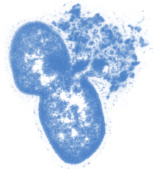
Selection Methods
Notes:
Combinatorial libraries are typically quite large and require selections. There are some cases, such as with rbs libraries, in which the libraries aren’t too big for screening. You need to calculate the theoretical diversity during design of your experiment and determine what type of screen or selection is required.

Slide 22
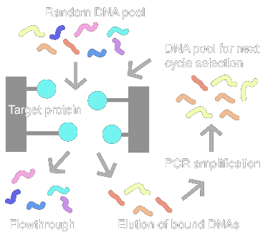
Adhesion Selections: SELEX
Notes:
The oldest method is SELEX which can be used to identify RNA or single-stranded DNA sequences that bind to a chemical or protein target. You begin with a library of DNA or RNA, typically with 10^15 membership generated by enzymatic processing of oligonucleotides with degenerate bases, as we discussed earlier.
You also need a column in which the target is immobilized. One method involves mixing cyanogen bromide-treated agarose beads with the protein target to get it covalently attached, but there are other stratetgies. You pass the library over the column, and very rare members will bind specifically to the target and become immobilized. Most of the library (>99%) will flow right through the column and be discarded. You then elute the bound DNAs from the resin and amplify them by RT-PCR. That gives you a new library of DNAs that can be reverse transcribed for another round of selection. You often have to perform selex multiple times. There is a great deal of non-specific binding during this process, so not only are the specific hits carried through in each round – you are simply enriching for these hits.

Slide 23
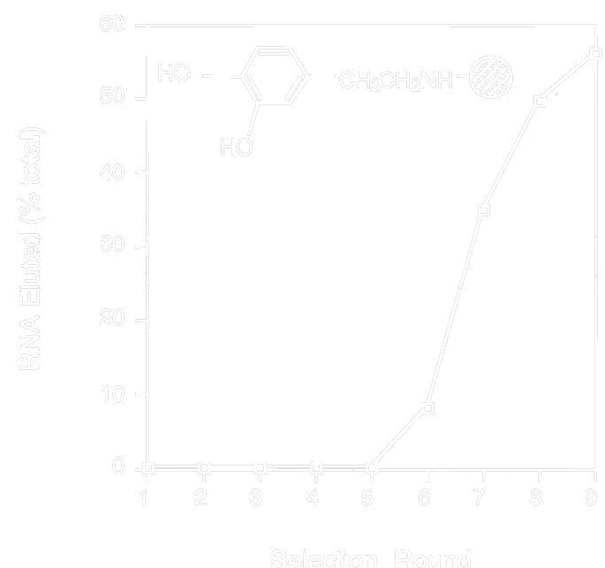
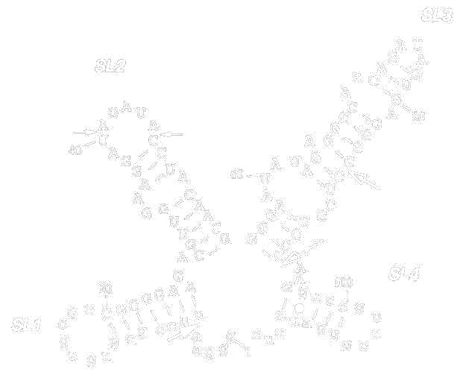
Example:
SELEX of dopamine aptamers
Biochemistry. 1997 Aug 12;36(32):9726-34. PMID: 9245404
Notes:
Typically it takes around 5 or 6 rounds of selection to see a signal, but if all goes well and you have hits, you’ll eventually get to a point where more of the material begins appearing after elution. At this point you would clone the library, pick individual members to sequence, and then characterize those hits further individually. New improvements to SELEX involve using microfluidic platforms for improved enrichment, and as we’ll talk about in the multiplex lecture, applying deep sequencing to characterize the hit pool.

Slide 24
Performance of a Selection
Specificity - how well the selection prefers the hit over the non-hit
Recovery - what fraction of the hits are passed during the selection
Enrichment – the fraction of hits in the final population divided by the initial population
Notes:
Before we see some additional examples, let’s discuss this concept of enrichment. These terms ‘enrichment’ ‘specificity’ and ‘recovery’ are quantitative measures of changes in the diversity of a library towards a subpopulation of ‘hits’. Enrichment is the main one which is just the frequency of your hits within the final population divided by their frequency in the initial population. Enrichment is determined by the specificity and recovery. Specificity is how well the selection prefers the hit over the non-hit, while recovery quantifies how efficient the selection is at retaining the hits. Typically you don’t need to worry about specifity and recovery, since they are rolled into enrichment, so let’s do an example of how enrichment is calculated.

Slide 25
Calculation of enrichment
Before
After
93 blue
1 red
red/red+blue = 0.0106
3 blue
183 red
red/red+blue = 0.984
Enrichment = 0.984/0.0106 = 92
Notes:
The calculation of enrichment requires that you follow the frequency of hits within your population before and after selection. Let’s consider the scenario of a cell that turns fluoresent red when a hit is present, and is blue otherwise. If we dilute and plate around 100 colonies of the naïve library on a plate, we can count the red and blue colonies, and then calculate the frequency of reds in the population. Now we apply a selection such as a FACS sorting, and repeat the plating experiment. Now we see that the frequency of reds is much higher.
<click>
If we take the frequency after selection and divide by the frequency before selection, we get the enrichment, which here would be 92.

Slide 26
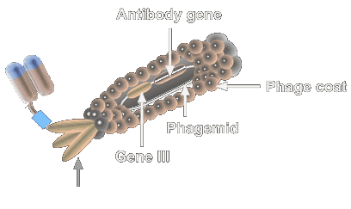
Phage Display: M13 Phagemids
pVIII Protein
pIII Protein
Notes:
To apply selections for binding to peptides and proteins, there is a challenge of connecting up the DNA encoding the protein with the protein molecule. Phage display is one of the earliest and most commonly-used strategy for doing this. The M13 phage particle is a long filamentous object which looks ultimately more like a pencil than what is illustrated here. The P8 protein coats the sheath of the particle and can be used for multivalent display of very short peptides (like, <8 aas). Longer proteins can be presented at single copy by fusion to the P3 protein at the tip of the particle. Operationally, you would begin the experiment with a Phagemid that encoded the P3 protein. A phagemid is just a plasmid that has an additional cis element required for packaging the DNA into an M13 particle. Otherwise, it is just like a normal pUC plasmid. You would make your library by fusion of things to P3 as you have done before in one of the tutorials. You’ll transform that library of phagemids into E. coli, and typically you can make up to 10^11 member libraries with this approach. The remainder of the M13 gene functions are provided by a helper phage. It’s basically a slightly crippled variant of M13. You infect the library with helper, and the progeny will be primarily packaged with the phagemid DNA and display the P3 fusion protein. You can then purify this phage material from the culture by precipitation and subject it to various selections.

Slide 27
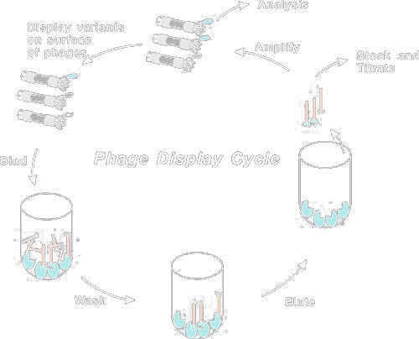
Phage Display
Notes:
The panning experiment used to select for peptides, antibodies, or the like that bind to a target of interest from a phage display library are very similar to SELEX. Because the particles are large, they tend to get stuck in agarose beads, so you typically do phage selections within the wells of a maxisorp plate such as is used for ELISA assays. You immobilize your target to the surface of the wells of the plate, block with milk or BSA, then add your library. If a phage binds, it will become immobilized and won’t wash off. You can then elute and infect the recovered particles onto E. coli to amplify them for subsequent rounds. The enrichments for phage display are similar to those of SELEX, so you will typically need to do multiple rounds of panning to enrich the hits away from non-specific binders.

Slide 28
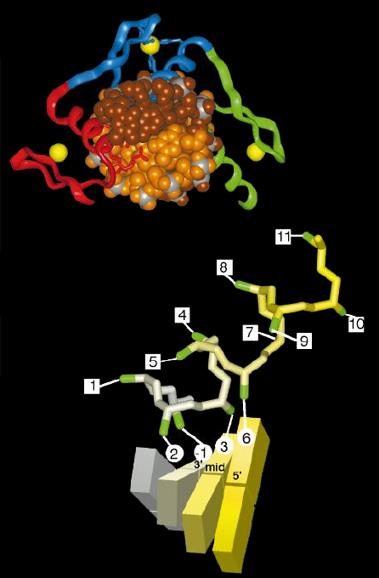
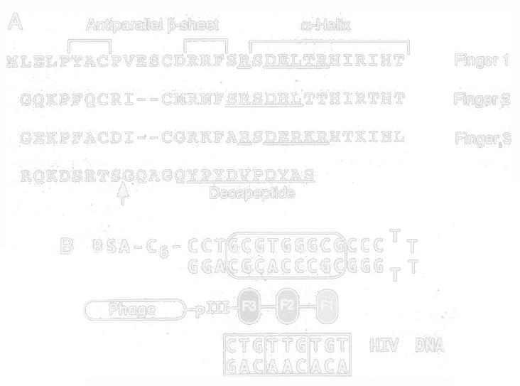
Engineering Zinc Fingers (Zif268)
J Mol Biol. 2000 Nov 3;303(4):489-502. PMID: 11054286
Proc Natl Acad Sci U S A. 1995 Jan 17;92(2):344-8. PMID: 7831288
Pubmed search “Zinc finger nuclease”
Notes:
Here is one of the more successful uses of phage display for identifying zinc finger proteins that bind to specific 3bp DNA sequences. On the left is the crystal structure of a 3-finger ZF protein bound to its DNA. The DNA is shown as a space-filling model and you are looking down the barrel of the helix. The yellow balls are the zinc atoms, one of which binds to each finger. So, you can see that specific regions of the fingers contact the DNA. Below, we zoom in on the regions of contact with the DNA showing the specific residues of contact. The attractive features of ZFs that encouraged this experiment was the consistency of the contact residues from finger to finger---they always use more-or-less the same residues to contact the DNA.
<click>
At right is the sequence of a three-finger ZF protein. The underlined regions are these contact residues, and in this study the authors apply saturation mutagenesis to these residues. They display the variant ZF proteins on the surface of M13 phage, and then perform panning against short DNAs that differe at one triplet. By doing this experiment at different triplets and seeing what gets pulled out, they were able to abstract out ‘rules’ for designing zinc fingers specific to many specific DNA sequences forming the basis for modern zinc finger nucleases.
More recently, similar experiments have been done with TAL proteins, and they are generally now regarded as the superior scaffold, but ZFs are still popular too.

Slide 29
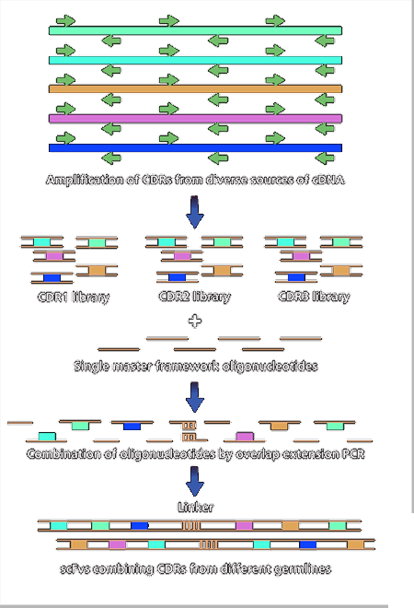
Engineering scFv Antibodies
Antibodies are primary drug scaffolds of modern big pharma
Many drug pipelines in industry around phage display technologies
Phage display allows mimetic methods of both affinity maturation and VDJ recombination
Can start with fully human versions of antibodies
Excellent for hard-to-immunize targets
“antibody phage display” = 2419 hits in pubmed
Nat Biotechnol. 2002 Dec;20(12):1189-90. PMID: 12454662
Mol Cells. 2009 Feb;27(2):225-35. PMID: 19277506
Nat Protoc. 2007;2(11):3001-8. PMID: 18007636
Notes:
The most common use of phage display is for antibodies. Companies that make anitbody drugs, like Genentech, generate their therapeutics in this way. Though there are other scaffolds such as affibodies, nanobodies, and monobodies that do similar things to antibodies, the immunological properties of antibodies are unmatched by another scaffold, and these are therfore the most popular scaffold for therapeutics.
By using fancy variations on library fabrication, it is possible to reconstitute the space of human-derived naïve antibodies in vitro and display them on phage. Because of this, phage display has largely eclipsed mouse immunization since you get something out of the experiment that can be directly used in humans.
Phage display also has the advantage here that some targets, particularly those associated with cancer, often do not elicity immune responses in animals. Many of the epitopes upregulated in cancer are associated with early embryonic development, and the antibodies to these targets are eliminated as self-reactive members. So, they have already been eliminated from the B-cell population. When you do the experiment in vitro, there is no such constraint and antibodies can be made against any target.

Slide 30
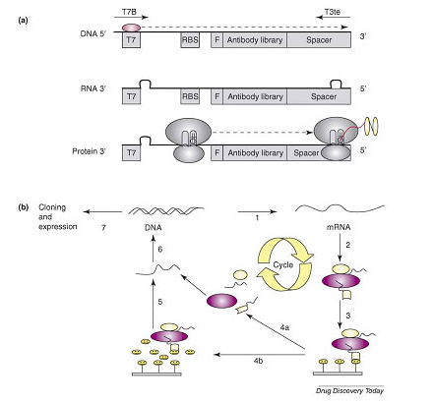
mRNA/Ribosome Display
http://www.creative-biolabs.com/others8.htm
Notes:
The major limitation in using phages is the need to transform your DNA into E. coli. This bounds the diversity you can access to 10^11 variants. Also, it becomes logistically more involved to use cells than it is to work in vitro. Therefore, people have developed various in vitro strategies for linking genotype to phenotype, and Ribosome display is the most prevalent of these methods. You start with a DNA encoding your DNA under a T7 promoter that lacks a stop codon. You transcribe these DNAs in vitro with T7 RNA Polymerase to generate an mRNA population, and then put this into in vitro translation mix. Ribosomes will stall when they reach the end of the mRNA forming a complex that links the nascent peptide to the mRNA. You can pan with these complexes just as you would in phage display. After selection, you reverse transcribe the mRNA to DNA, PCR, then repeat.

Slide 31
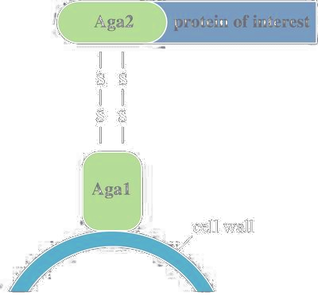
Cell Surface Display
Yeast Display:
Notes:
Another strategy for binding-based selections is cell-surface display. Here, you will decorate the surface of the cell with the protein encoded on a plasmid within the cell to couple genotype and phenotype. It can be done in multiple organisms including E. coli and yeast, and different systems are useful for different things. Shown here is yeast display. You fuse your gene to this protein Aga2 which gets exported and deposited on the surface with disulfide bonds. This yeast system can handle-full length proteins, but the transformation efficiency of yeast limits the library to 10^7.

Slide 32
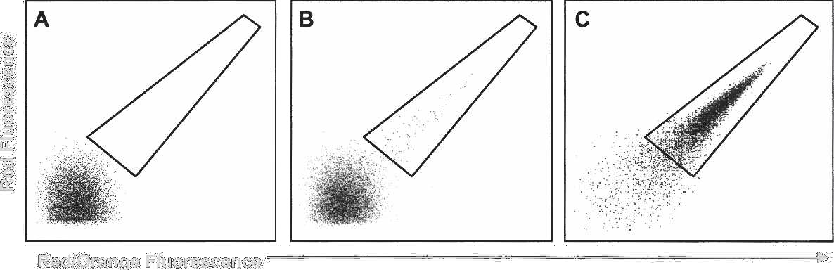
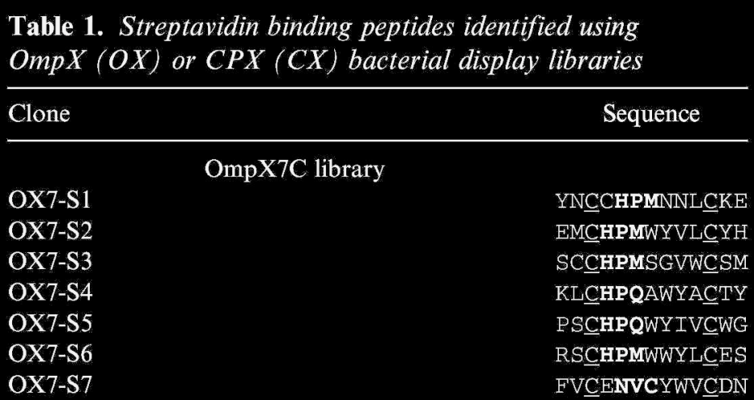
Example:
Selection of streptavidin-binding peptides
Protein Sci. 2006 Apr;15(4):825-36. PMID: 16600968
Notes:
The E. coli systems are all based on inserting or fusing a peptide into a cell-surface display protein. There are many such systems including OmpX and CPX which are outer membrane barrel proteins derived from E. coli. Probably the most robust is ice nucleation protein. You can reliably display peptides up to ~80 amino acids on the surface, but longer proteins have a much lower success rate. In this version, they are placing an X2CX7CX2 peptide in a loop of the protein. They show that the disulfides are helpful in constraining the conformation of the peptide resulting in better hits.
<click>
It is possible to do selections with magnetic beads or maxisorp plates, but such experiments often result in the selection of flocculating mutants or weak binders due to the multivalent display. So, in practice that strategy is unlikely to work. Instead, you label the surface of the cell with a fluorescently-tagged version of your template and then sort the fluorescent cells with a cytometer. Such reagents can be made by cloning your gene into an overexpression vector, expressing it in some cell, purifying the protein, and then reacting it with FITC, TrITC, or other reactive dyes. After several rounds of labeling and sorting, you get a fluorescence signal, and at that point you can clone and sequence your library.

Slide 33
Direct Complementation
Create a strain with a deletion in the activity of interest
Identify growth conditions that allow wild-type to survive, but mutants die
Transform in a library of plasmids containing potential activities that would “complement” the deletion
Select for growth under the non-permissive conditions
Notes:
The remainder of these selection methods are all in vivo selections. Meaning, they are selections applied to live cells and they are somehow based on the survival of the cells. There is also a class of liposome and micelle-based selections, but we’ll save that for the multiplex lecture. The simplest one is complementation, which has been a staple of genetics since the 1950s. Much of what we know of biology comes from a process of generating mutants and then screening for DNA fragments that correct or complement them. For example, you might treat E. coli with radiation, then pick a bunch of colonies and try to grow each one on a minimal media. If it is unable to produce even one of its metabolites, the cell will be unable to grow. You call such mutants auxotrophs. Usually the defect will be present in only one gene, and introduction of a functional copy of this gene will restore growth. So, if you transform these cells with a library of plasmids encoding fragments of the genome, or a genomic dna library, only those transformants that receive the functional copy will survive, and then you can sequence the plasmid to find out what you hit.
That experiment falls under the category of ‘forward genetics’ and it is no longer so prominently used. The advent of genome engineering strategies allows you to knockout a gene directly now, allowing a more hypothesis-driven approach.
When used in the context of genetic engineering, you employ complementation in a more targeted way. You construct a strain with a deletion in the activity of interest and then play with growth conditions until you find ones in which the wild-type survives and the mutants die. You then make a library out of the knocked out gene, or perhaps with other proteins you think might satisfy the required function of this gene, and you introduce that into the mutant cells. You then grow the library under non-permissive conditions and collect your hits.

Slide 34
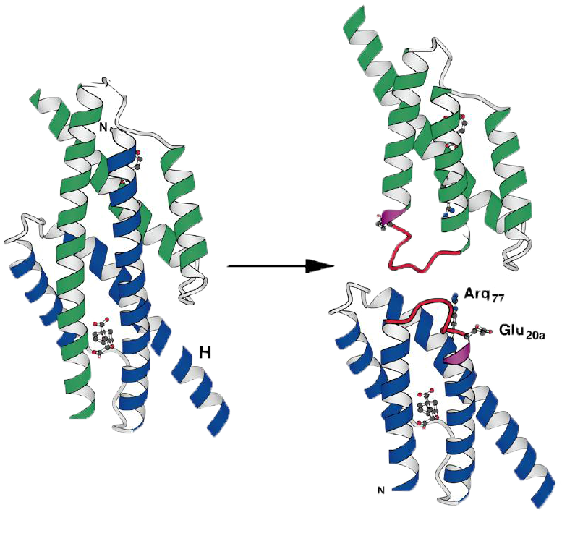
Example:
Selection of a monomeric chorismate mutase
Linker Library:
-Leu20-Lys21-Xaa-Xaa-Xaa-Xaa-Xaa-Xaa-Leu20a-Lys21a
KA12/pKIMPUAUC: E. coli strain with chorismate mutase gene knocked out
Grow library on minimal media (without supplying aromatic amino acids)
Science. 1998 Mar 20;279(5358):1958-61. PMID: 9506949
Notes:
Here is an example of protein engineering using a complementation selection by Hilvert. They begin with a chorismate mutase knockout strain. This enzyme is involved in the biosythesis of the aromatic amino acids, so mutants need to be fed aromatic amino acids (tyrosine, phenylalanine) to survive on minimal media. They then construct a library derived from the original gene. Wild-type chorismate mutase is a domain-swapped dimer, and they examined the crystal structure to identify a site in which each monomer could be cleaved in half, and then rejoined by a random linker. If the linker can satisfy the structural constraints, the topology of the enzyme would be changed resulting in a monomeric version. The library contained 6 X sites (or NNK sites). They insert the library into the knockout strain and then grow on minimal media. They pull out hits and go on to confirm that they are indeed monomers.

Slide 35
Synthetic Selections
Often any selection involving DNA as the library is referred to as “genetic selection”
That would include complementation selections
Sometimes it specifically refers to “in vivo selections” meaning a selection in which the activity of the library member is linked to the viability of the cell
Synthetic selections involve some contrived linkage between genotype and selection
Notes:
Many people refer to the class of selections that involve linkage of a gene’s function to its ability to grow as a ‘genetic selection’. Some folks use the term to more generally mean any selection that enriches for DNA sequences including SELEX. ‘In vivo selections’ is usually reserved to specifically mean the condition in which the viability of the cell is linked to a target gene.
<click>
There isn’t a consistent name for what I’ll call here a ‘synthetic selection’, but they involve some type of genetic circuit that links the target gene’s activity to survival of the cell in a more circuitous way. These methods are often the only way to probe the function of a gene, particularly when it is not a native activity of the cell.

Slide 36
Example:
Changing the specificity of LuxR
3OC6HSL
or C10HSL
LuxR
AHL
luxR
CmR
PluxI
Nat Biotechnol. 2006 Jun;24(6):708-12. PMID: 16715074
Notes:
Let’s look at an example of a synthetic selection. Let’s say you want to engineer the substrate specificity of LuxR. LuxR is a transcription factor from Vibrio fisherii that binds to a homoserine lactone small molecule and in response activates transcription from the LuxI promoter. It’s a component of quorem sensing systems and a very popular gene in synthetic biology. You want to make a library out fo the LuxR active site and then select for variants that respond to a different small molecule. There is no LuxR-like activity in E. coli natively, so there is no gene to knockout that it would complement, so those experiments are out. Perhaps you could do a panning experiment against the new substrate immobilized on a column, but that would be a selection for binding, not for the combination of binding and transduction.
The easiest solution here is going to be some type of synthetic selection. There probably are better micelle-based solutions to be developed, but of the existing technologies an in vivo selection will do the job the best. Here, Arnold has placed a chloramphenicol resistance gene downstream of luxI. If a functional luxR is present, then the luxI promoter will turn on. If luxI promoter gets activated, the cell will survive in the presence of chloramphenicol. So, operationally, you would construct a strain with this PluxI-CmR cassette, usually on a plasmid, and then introduce a library of LuxR variants then select for survival on the new small molecule (here, C10HSL) and sequence what survives.
This type of genetic selection can be applied to any transcriptional process – whatever it is you want to select for, if it turns on a promoter in the end you can hook it up to a selectable marker and make it selectable. That also applies to any singular interaction within a transcriptional activation process.

Slide 37
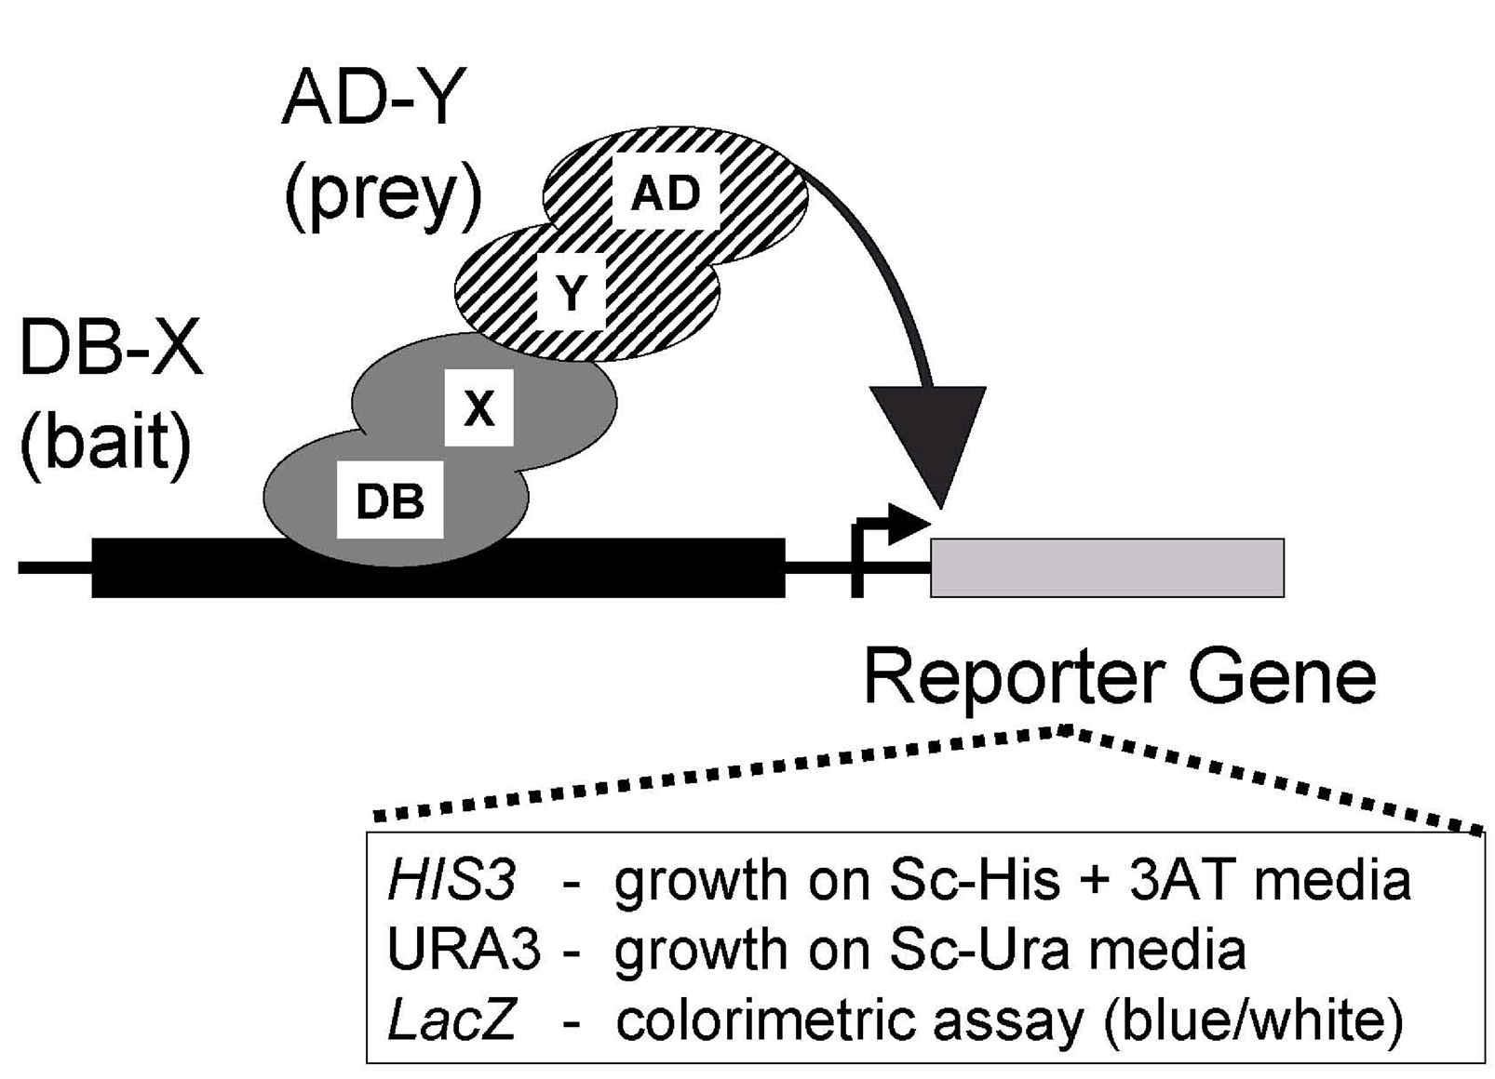
Example:
Two hybrid systems
Notes:
Here’s another example: the two-hybrid system. The two hybrid is a genetic selection selection based on recruiting an RNA polymerase to a promoter. There are prokaryotic systems available, but this is almost always done in yeast with GAL4 promoter. The experiment takes advantage of the fact that eukaryotic transcriptional activation is largely a localization problem, and one simply needs to tether an activator near the promoter to achieve activation. The mechanisms of transcriptional activation in bacteria are more geometrically constrained, so prokaryotic systems tend to be less extensible than their eukaryotic counterpart.
In the yeast two hybrid, you start with the GAL4 promoter in front of various selectable markers. Yeast selections are usually based on metabolic complementation rather than antibiotic resistance genes, but they are morally equivalent – if the gene turns on the cells selectively survive.
The transcription factor that normally activates GAL4 is split into separate DNA binding and activation domains (DB and AD respectively). Each domain is fused to your protein of interest, shown here as X and Y. If X and Y form a protein-protein interaction, then the activation domain is recruited and transcription results. So, let’s say you wanted to identify an affibody that bound to some particular protein Y. You’d engineer a cell that expresses Y fused to AD and the GAL4 promoter driving the selectable marker. You’d encode the DB fused to your library of affibodies on a plasmid, then transform. You grow the resulting cells under selective growth conditions, and only those affibodies that bind to Y should survive.
So, this is an example of using a synthetic circuit to do the same sort of selection that would more typically be done using phage display. Any aspect of this circuit can be subjected to a library. For example, you might alter the DNA sequence below DB and make a library of DNA binding domains such as a zinc finger library.

Slide 38
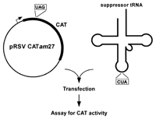
Example:
Amber suppression
Notes:
Synthetic selections and genetic selections have only been constructed for a handful of systems. Another successful one is with suppressor tRNAs. These selections form the basis for most work in site-directed incorporation of unnatural amino acids. Here, you place a TAG stop codon (the amber stop codon) somewhere in the gene for a selectable marker, here chloramphenicol acetyltransferase which confers resistance to chloramphenicol. When the ribosome reads the mRNA’s of this gene, it encounters the stop and prematurely terminates, and the cells are unable to grow on media containing chloramphenicol. If you introduce a library of suppressor tRNAs in which the anticodon is replaced with CUA, some of these tRNAs may get charged by an amino acid and allow decoding of the amber stop leading to full-length product and survival. Thus, you can select for functional suppressor tRNAs.
You can construct a synthetic selection for any situation in which you can link the function of interest to expression of a selectable marker. You can control expression of a selectable marker at the DNA level (such as selection for recombinases) at the transcriptional level (transcriptional initiation, elongation, or termination) or at the translation level. Amber suppression is an example of translational control during elongation, but you can also do selections based on translation initiation or termination. For example, you could place riboregulators upstream of a selectable marker that hide the ribosome binding site, and then select for RNAs or proteins that disrupt the secondary structure and reveal the RBS.

Slide 39
Dual Selections
aka double sieve selections, positive/negative selections
An “Indirect” genetic selection
The activity of interest is linked in a synthetic way to the viability of the cell
Requires linkage in both a positive and a negative mode such that the cell can be made to survive or die in response to the desired activity
A stimulus of some sort must be present to switch on or off the desired activity
Great for changing the specificity of a nascent biological activity
Notes:
Thus far we’ve considered exclusively direct selections: the aptamers bound to the beads during selex and survived, the bait protein bound to the prey in the two hybrid, and the tRNA suppressed the mutation and survived. In some cases, what you are trying to identify from a library is not this activity, but rather this activity conditioned on some constraint. For example, you might want a tRNA that suppresses amber stops, but it does so only when an aminoacyl-tRNA synthetase is present. Or, you might want a transcription factor that activates a promoter in the presence of a small molecule, but you may also want to require that it does not activate the promoter when the small molecule is absent.
For these sorts of situations, the established way to do it is a dual selection. However, with the advent of deep sequencing there are new approaches which we’ll discuss in the multiplex characterization lecture. In a dual selection, you start with a synthetic selection, but your selectable marker can be positive (as we did before) or negative. Meaning, we have a reporter gene that when activated will kill the cell. Such experiments also require a stimulus. In the case of the tRNA that requires a specific synthetase, that stimulus is the synthetase. In the case of the transcription factor that requires a small molecule, the stimulus is the small molecule. You perform dual selections in two rounds: you first apply the positive selection in the presence of the stimulus, and then you withhold the stimulus and apply the negative selection.

Slide 40
Example:
Changing the specificity of LuxR
3OC6HSL
or C10HSL
LuxR
AHL
luxR
Pos or Neg
PluxI
Nat Biotechnol. 2006 Jun;24(6):708-12. PMID: 16715074
Notes:
Let’s go back and examine the Arnold study. In this study, they actually do a dual selection. So, I’ve changed the diagram here to indicate that the selectable marker is not just a cat gene, it’s going to be a little genetic circuit that can be selected for or against.

Slide 41
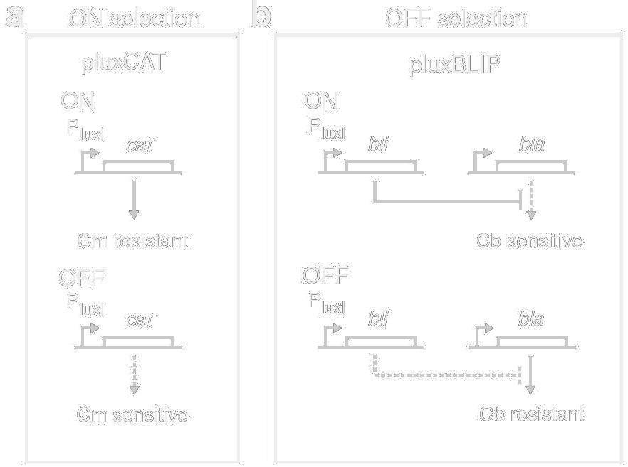
Example:
Changing the specificity of LuxR
Nat Biotechnol. 2006 Jun;24(6):708-12. PMID: 16715074
Notes:
For positive selection, they employ the PluxI-cat construct as discussed before. For the negative selection, the LuxI promoter drives the blip gene encoding a beta-lactamase inhibitory protein. They also provide a consistutively-expressed Bla gene. The selection strain here is ampicillin resistant. However, if PluxI is activated, BLIP is expressed, Bla is inactivated, and the cells die on the antibiotic. So, you can select against a functional LuxR.
Operationally, they first apply the ON selection in the presence of their new small molecule C10HSL. They then apply the negative selection in the presence of the old small molecule 3OC6HSL. If you just apply the positive selection in such an experiment, you tend to pull out many variants that are consititively on either by responding to an endogenous metabolite or by an internal conformation change. However, when you include the negative selection, the only things that can pass both selections are the ones specific to the small molecule.

